Slide 1
CHAPTER 6
The Tools of the Astronomer

Slide 2
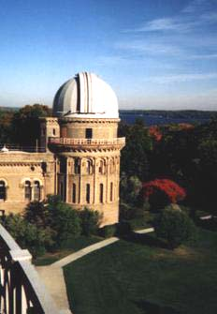
40 inch refracting telescope at Yerkes Observatory

Slide 3
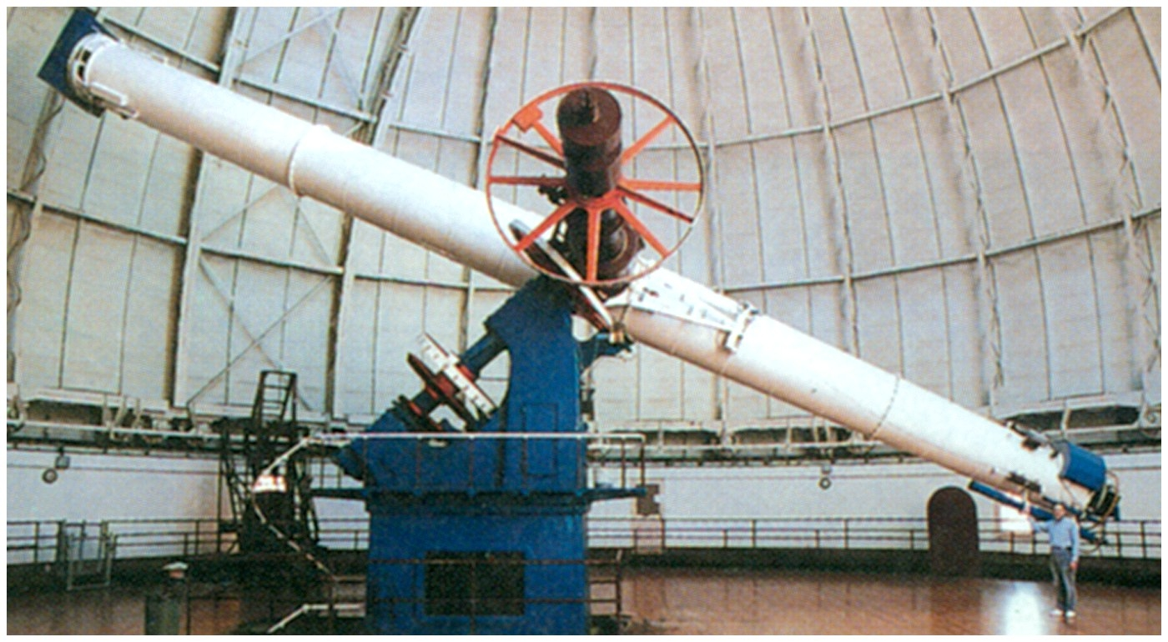
The refracting telescope at Yerkes - 63 feet long.

Slide 4
Chromatic Aberration

Slide 5
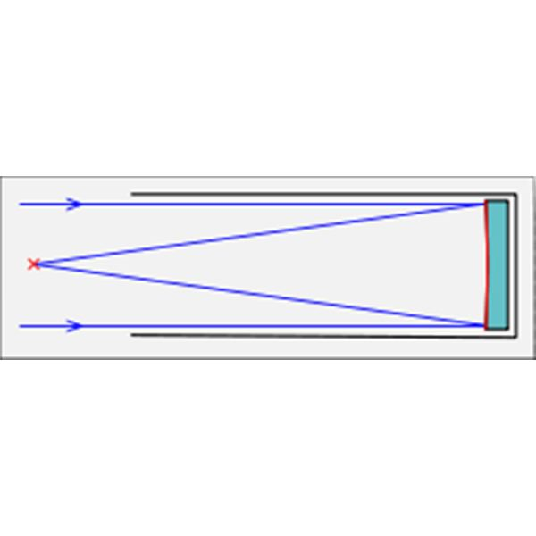
Reflecting telescope

Slide 6
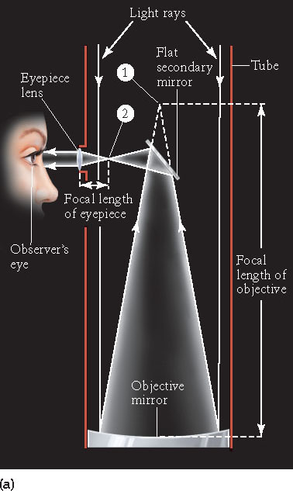
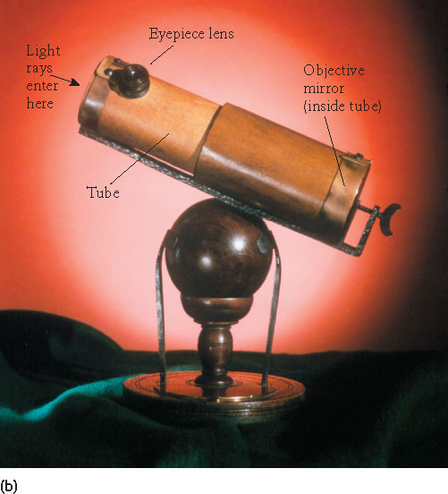
Newtonian Focus

Slide 7
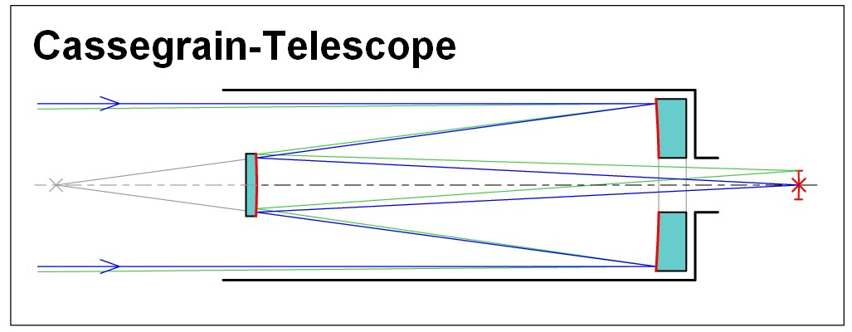

Slide 8
A Cassegrain telescope has a hole in the main mirror. This reduces the mirror area and thus the light gathering power, but how much?
Suppose a 10 inch diameter mirror has a one inch diameter hole in the center. How much of the light gathering power is lost because of the hole?
1% 2) 10%
50% 4) 90%

Slide 9
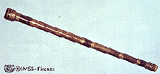
One of Galileo’s early telescopes

Slide 10
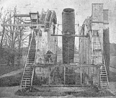
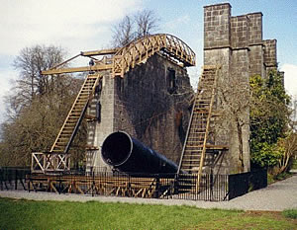
Earl Rosse’s
“The Leviathan
Of Parsonstown”
(Ireland) 72 inch mirror
1845

Slide 11
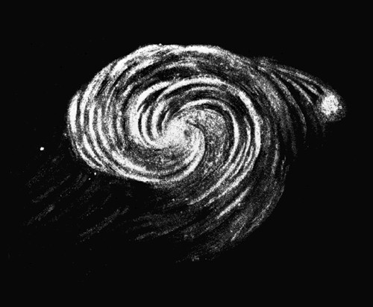
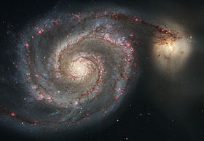
The Whirlpool Galaxy (M51)
A drawing by Earl Rosse in 1845 and a modern image

Slide 12
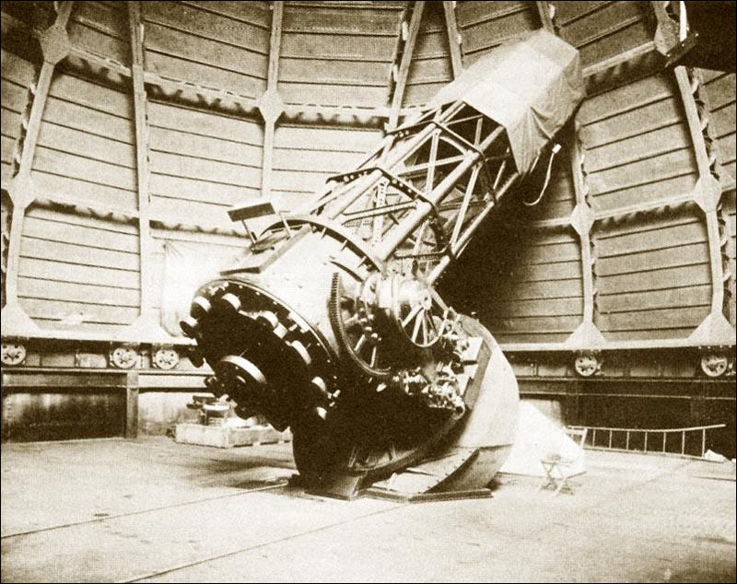
The 100” Telescope at Mt. Wilson

Slide 13
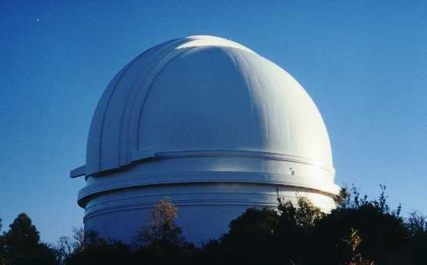
The dome at Mount Palomar

Slide 14
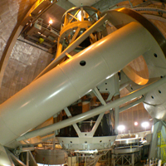
200 inch telescope at Mount Palomar

Slide 15
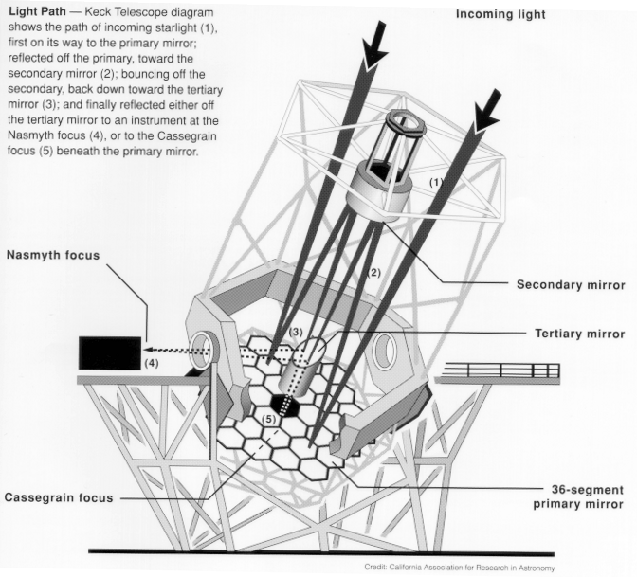
Keck
10 meter segmented telescope

Slide 16
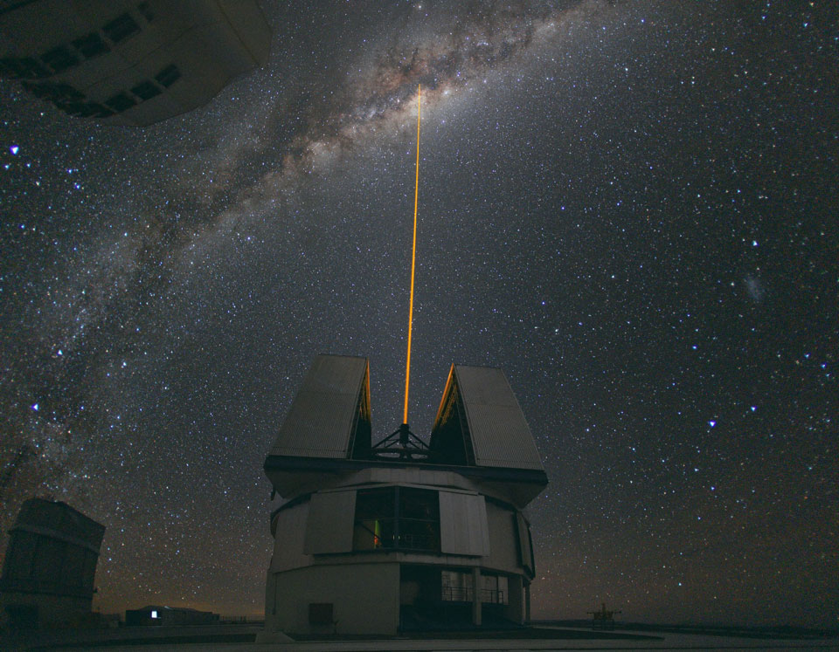
Laser for Adaptive Optics
APOD 2013 December 1

Slide 17
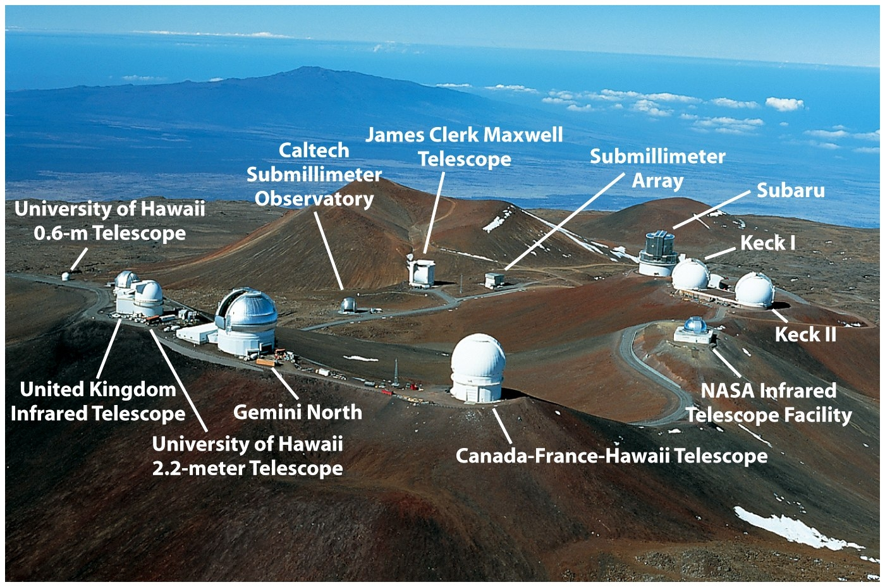
Mauna Kea, Hawaii

Slide 18
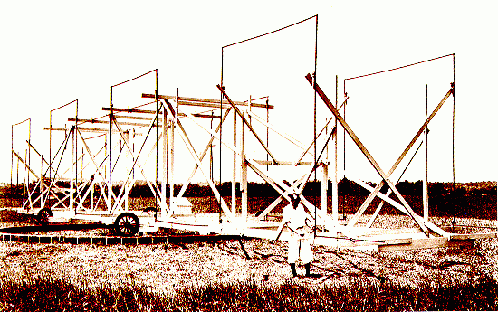
Karl Jansky with his radio telescope, 1931

Slide 19
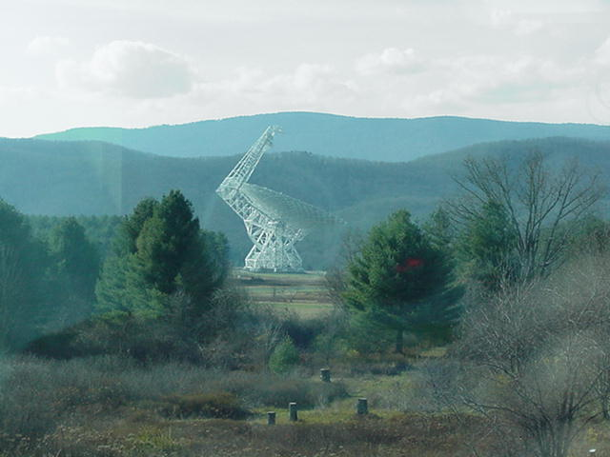
Greenbank Radio Telescope

Slide 20
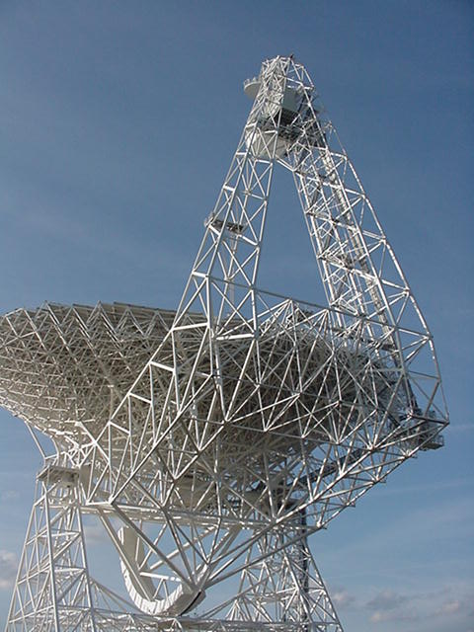

Slide 21
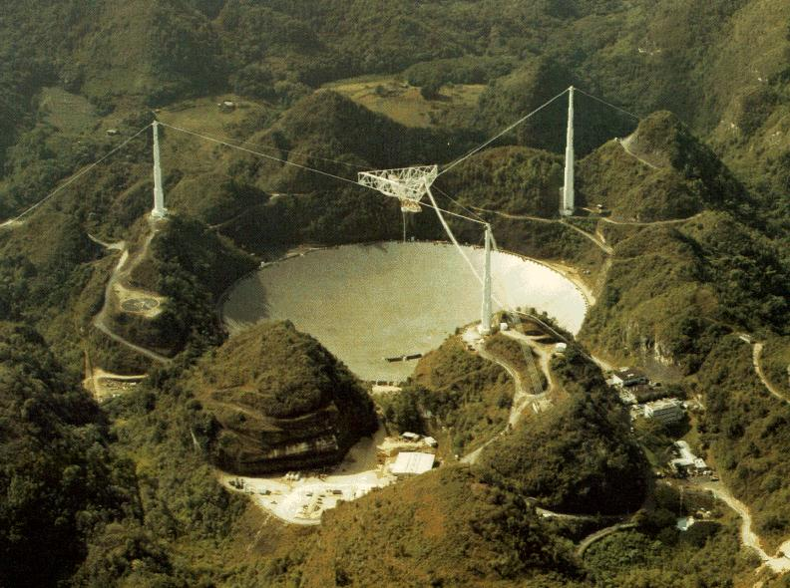
Arecibo Radio Telescope

Slide 22
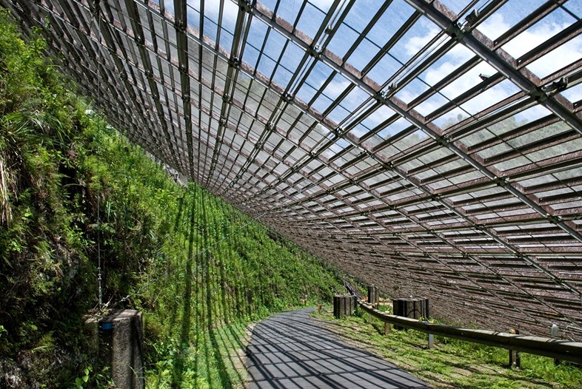
Arecibo

Slide 23
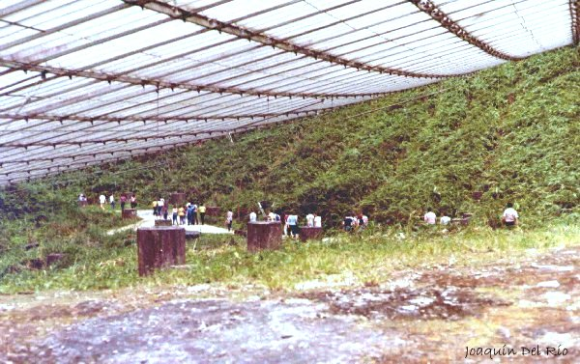
Below the dish at Arecibo

Slide 24
The two portions of the Electromagnetic Spectrum which penetrate Earth’s atmosphere most easily are visible and
x-ray. 2) ultraviolet.
3) infrared. 4) radio.

